Slide 1


Data Engineering Project
Automating ELT Data Pipelines with Airflow: Load & Transform data to BigQuery
Extract , Load & Transform 1 Million Records

Slide 2
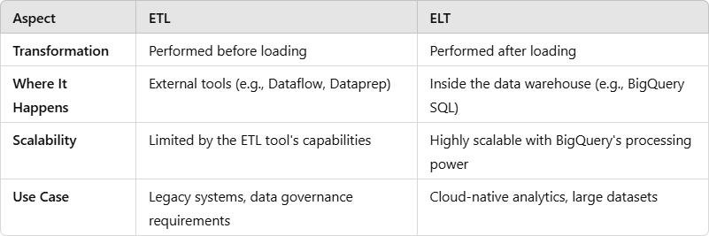
ETL vs ELT

Slide 3
Requirements
The Medical Research Team receives a global health statistics file containing disease data for all countries.
Each country's Health Minister should have access only to their respective country's medical data.
Additionally, they need the ability to analyze diseases for which no treatment or vaccination is currently available.
Challenges
The data is currently provided as a single file containing over 1 million records for all countries.
Due to the confidential nature of the data, it is not feasible to share the entire file with everyone.
Analysing such a large CSV file to extract meaningful insights is complex and inefficient.
•
Objective
Develop a robust data analytics solution to securely manage and filter this data, ensuring restricted access and enabling efficient analysis of diseases without available treatment or vaccination.

Slide 4

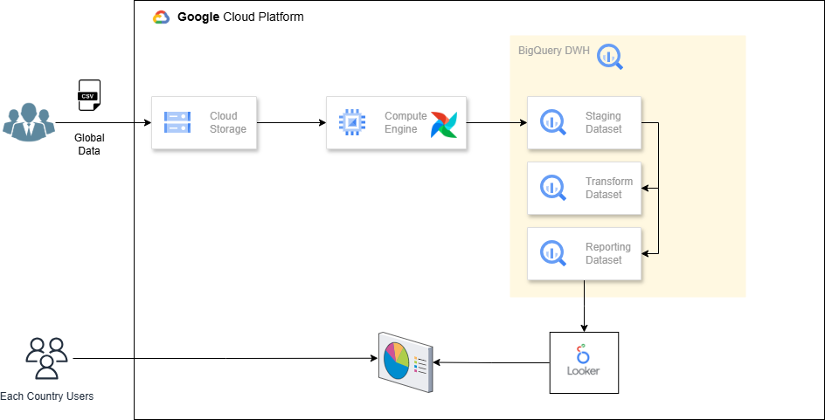
Architecture

Slide 5
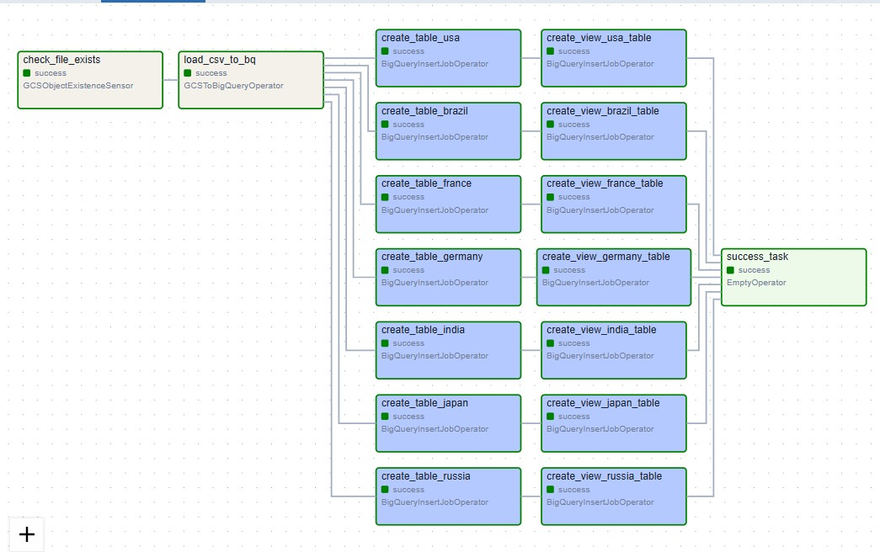
ELT Data Pipeline

Slide 6
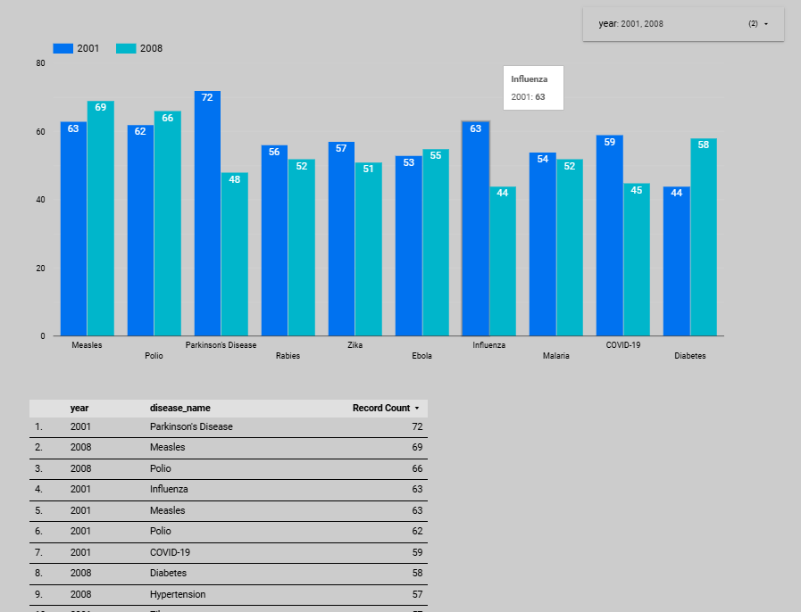
Looker Studio Dashboard

